Slide 1
A Many-objective Evolutionary Algorithm with Reference Point-based and Vector Angle-based Selection
Chen-Yu Lee, Jia-Fong Yeh, and Tsung-Che Chiang
Department of Computer Science and Information Engineering
National Taiwan Normal University, Taiwan
The 11th International Conference on Genetic and Evolutionary Computing (ICGEC 2017), Kaohsiung, Taiwan, Nov. 6, 2017

Slide 2
Outline
Introduction
Proposed Algorithm
Reference point-based selection
Vector angle-based selection
Hybrid
Experiments and Results
Conclusions

Slide 3
Introduction
Multiobjective optimization problem (MOP)
Minimize (maximize) F(x) = (f₁(x), … , f_{m}(x))
x: solution, x ϵ Ω
Ω: decision space, f_{i}: the i^{th} objective function
Many-objective optimization problems (MaOP) refer to MOPs with more than three objectives.

Slide 4
Introduction
dominates
f₂
Pareto optimal
Pareto dominance (assume minimization)
F(x) = (f₁(x), … , f_{m}(x))
F(x) dominates F(y) iff
(1) f_{j}(x) ≤ f_{j}(y) for all j = 1, 2, …, m
(2) f_{j}(x) < f_{j}(y) for at least one j ϵ {1, 2, …, m}
f₁
Pareto front

Slide 5
Introduction
The goal of solving a MOP is to find or approximate the Pareto front (PF).
Convergence
(as close as possible)
Distribution
(as even as possible)
f₂
f₂
PF
Pink is better than green.
f₁
Pink is better than green.
f₁

Slide 6
Selection of Individuals
NSGA-II [1]
nondominated-sorting
crowding distance
(for convergence)
(for distribution)
f₂
f₂
f₂
d(A) = d1 + d2
d1
d2
A
B
f₁
(rank 1) is better than
(rank 2).
f₁
A is better than B (since B's area is more crowded).
f₁
[1] K. Deb, A. Pratap, S. Agarwal, and T. Meyarivan, “A fast and elitist multiobjective genetic algorithm: NSGA-II,” IEEE Transactions on Evolutionary Computation, vol. 6, no. 2, pp. 182–197, Apr. 2002.

Slide 7
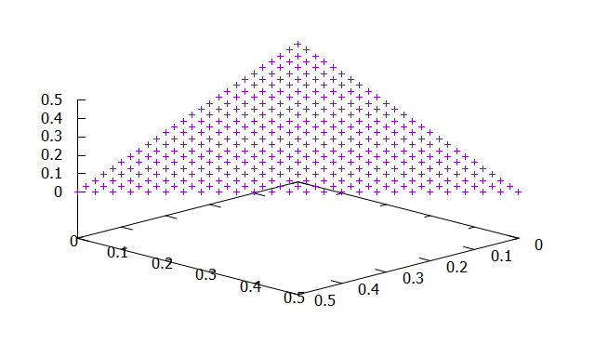
Reference point-based selection
NSGA-III [2] controls the distribution by reference points.
f₃
( 1, 0, 0)
(2/3, 1/3, 0)
(1/3, 1/3, 1/3)
( 0, 2/3, 1/3)
( 0, 1, 0)
Reference point
Individuals
niche count = 1
Association
…
niche count = 3
f₂
f₁
[2] K. Deb and H. Jain, “An evolutionary many-objective optimization algorithm using reference-point based non-dominated sorting approach, part I: Solving problems with box constraints,” IEEE Transactions on Evolutionary Computation, vol. 18, no. 4, pp. 577–601, 2014.
Notes:
NSGA-III uses a niching procedure to replace the crowding distance.
An adaptive normalization method is used to construct a hyperplane
A set of reference points are then produced on the hyperplane
Each individual is associated with a reference point based on the perpendicular distance to the reference line passing the point
The number of associated individuals of a reference point measures the density of the corresponding region
By favoring individuals in low-density regions, NSGA-III can maintain a well-distributed population

Slide 8
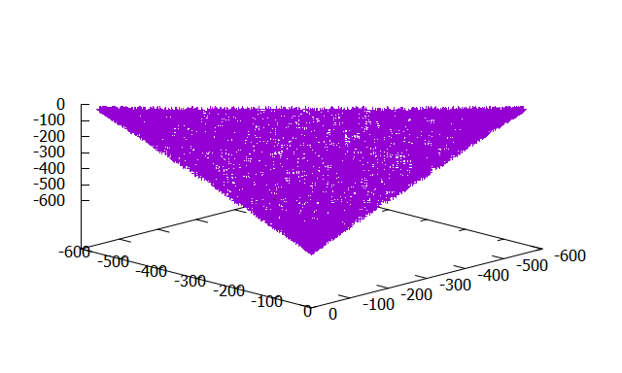
Vector angle-based selection
VaEA [3] points out that generation of reference points is a challenge.
RPs fit PF.
Pareto front of DTLZ1
do not fit
Pareto front of DTLZ1⁻¹
[3] Y. Xiang, Y. Zhou, M. Li, and Z. Chen, “A vector angle-based evolutionary algorithm for unconstrained many-objective optimization,” IEEE Transactions on Evolutionary Computation, vol. 21, no. 1, Feb. 2017.
Notes:
The number of reference points increases very quickly as the number of objectives gets high
uniformly-distributed reference points cannot guarantee uniformly-distributed solutions when the problem has an irregular Pareto front
VaEA was proposed as an optimizer based on the search directions of the population itself

Slide 9
Vector angle-based selection
VaEA considers distribution based on the angle between collected individuals (P) and uncollected individuals (Fl).
f₂
P
Fl
Maximum Vector Angle First: y is preferred than x and z.
x
a
b
y
z
c
f₁
Notes:
The maximum-vector-angle-first principle collects from uncollected individuals the one has the largest minimal angle from the collected individuals
The worse-elimination principle replaces one collected individual by an uncollected individual if the angle between them is small and the uncollected individual has better convergence

Slide 10
Hybridization
NSGA-III + VaEA
NSGA-III
?
How to select in a non-zero-member cluster (not randomly)
Let VaEA help (based on angle).
Let NSGA-III help (based on RP).
VaEA
?
How to select the initial members for reference

Slide 11
Experiments and Results
Benchmark functions
The negative version of DTLZ1-4 [4][5]
Number of objectives: 3, 5, 8, 10
Tested algorithms
NSGA-III
VaEA
Improved NSGA-III (I-NSGA-III)
[4] H. Ishibuchi, Y. Setoguchi, H. Masuda, and Y. Nojima, “Performance of decomposition-based many-objective algorithms strongly depends on pareto front shapes,” IEEE Transactions on Evolutionary Computation, vol. 21, no. 2, pp. 169–190, Apr. 2017.
[5] K. Deb, L. Thiele, M. Laumanns, and E. Zitzler, “Scalable test problems for evolutionary multi-objective optimization,” in Evolutionary Multiobjective Optimization, A. Abraham, L. Jain, and R. Goldberg, Eds. London, U.K.: Springer-Verlag, 2005, pp. 105–145.

Slide 12
Experiments and Results
Performance measure: Inverted generational distance (IGD)
Parameter setting is the same as NSGA-III and VaEA.
The population size and generation number depend on the DTLZ function and objective number.
20 independent runs
f₂
Pareto front
Approximation
f₁

Slide 13
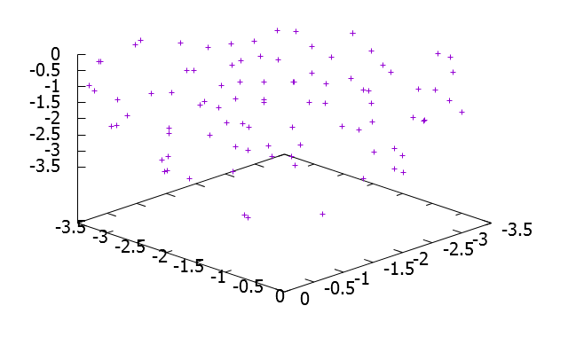
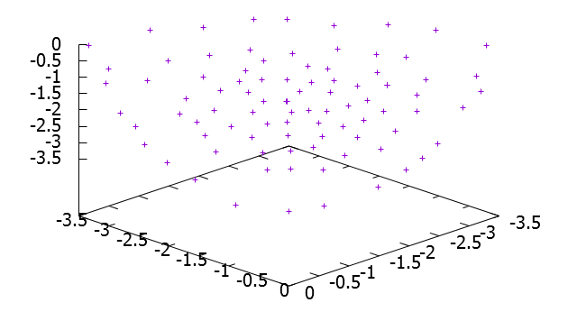
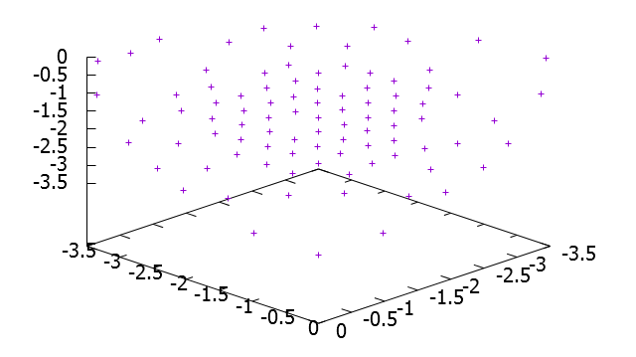
Experiments and Results
Plot of obtained solutions in one run for DTLZ2⁻¹ with M = 3
NSGA-III
VaEA
I-NSGA-III

Slide 14
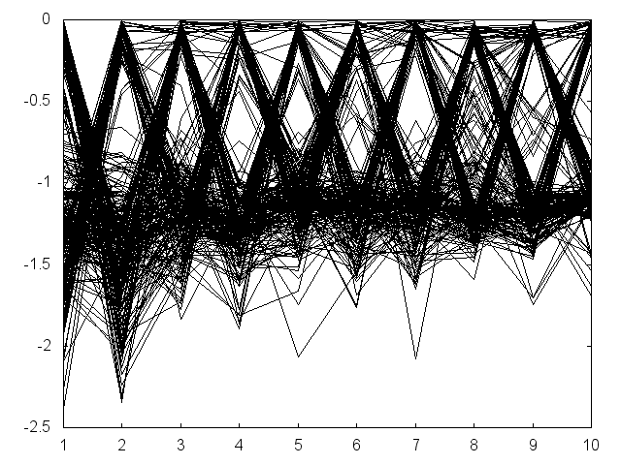
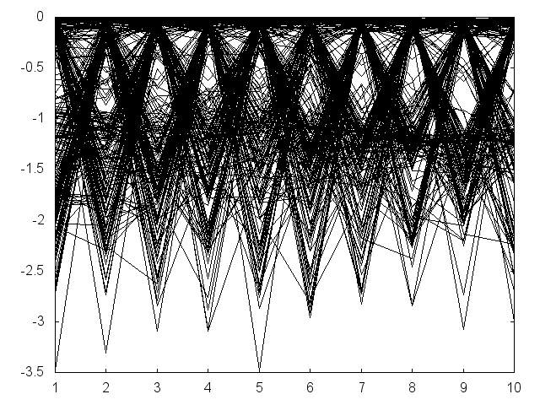
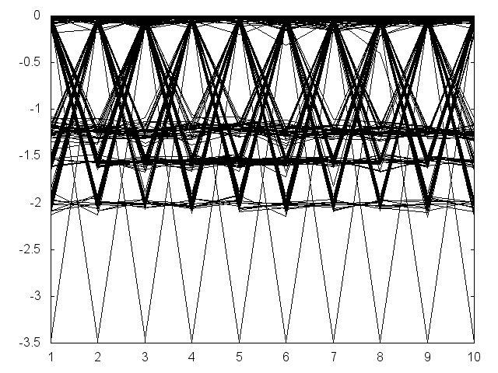
Experiments and Results
Value path plot of obtained solutions in one run for DTLZ2⁻¹ with M = 10
objective value
objective value
NSGA-III
VaEA
objective number
objective number
objective value
I-NSGA-III

Slide 15
Conclusions
This paper addressed the selection procedure in many-objective evolutionary algorithms.
The selection procedures in NSGA-III and VaEA are studied, and a hybrid method was proposed.
Experimental results showed that the proposed I-NSGA-III outperformed the NSGA-III and is competitive to VaEA.
Besides, I-NSGA-III can expand the front better than NSGA-III and VaEA.
How to keep good distribution and extreme solutions simultaneously is the next topic to study.

Slide 16
Thank you for listening.

